Slide 1
Learning & Development Enabling development, Impacting growth…
BIG-04
Hadoop 2.0 & YARN – Module 03

Slide 2
Module outline(continued)
Difference between Hadoop 1.0 and 2.0
New Components in Hadoop 2.x
YARN/MRv2
Configuration Files in Hadoop 2.x
Major Hadoop Distributors/Vendors
Cluster Management & Monitoring
Hadoop Downloads
Q & A

Slide 3
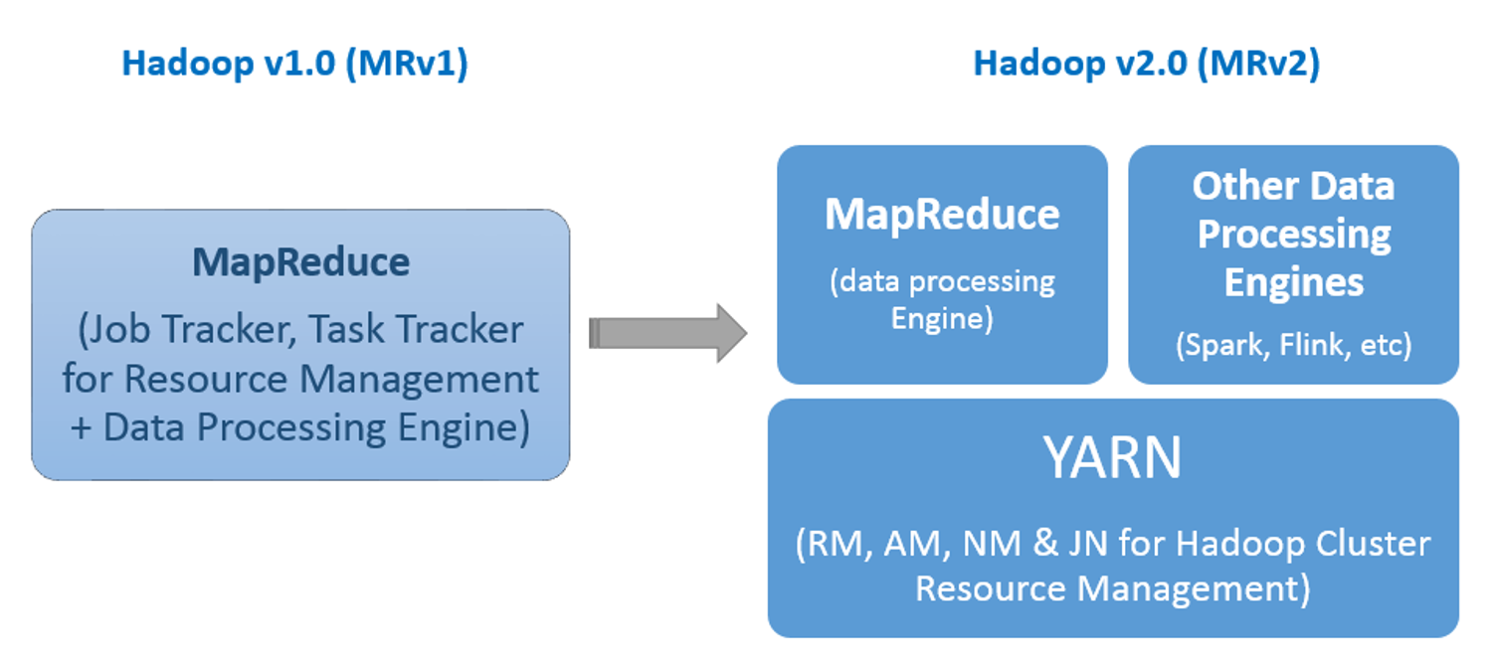
Difference between Hadoop 1.0 and 2.0

Slide 4
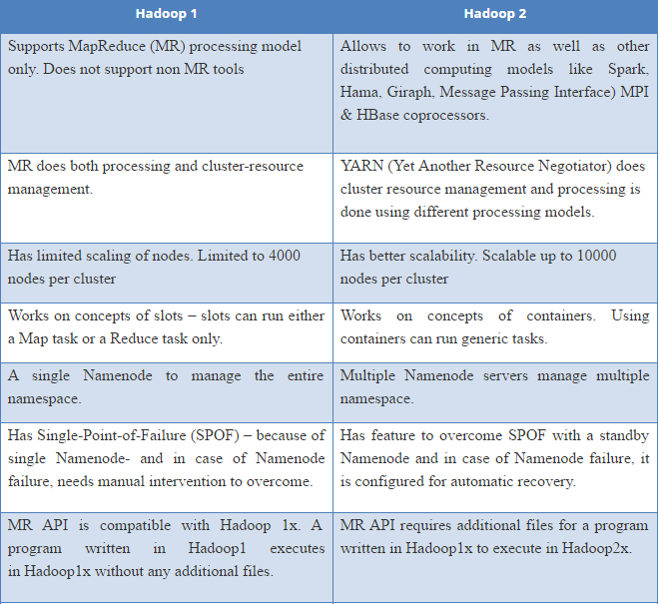
Difference between Hadoop 1.0 and 2.0(continued)

Slide 5
New Components in Hadoop 2.x
HDFS Federation
Multiple Federated Name Nodes
Multiple Namespaces
HDFS High Availability(HA)
Automatic Failover
YARN (Yet Another Resource Negotiator)

Slide 6
New Components in Hadoop 2.x- HDFS Federation
According to Webster’s: a federation is an organization or group within smaller divisions have some degree of internal autonomy
HDFS Federation refers to the ability of Name Nodes to work independent of each other.
Federation allows
a cluster to scale by adding name nodes, each of which manages a portion of file system namespace.
Example: One name node manages files under /user and second may manage files under /share directory

Slide 7
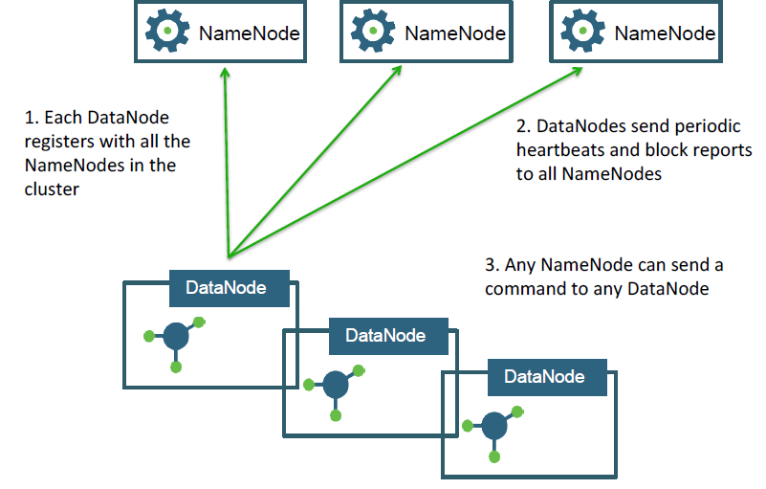
New Components in Hadoop 2.x- Multiple Federated Name Node

Slide 8
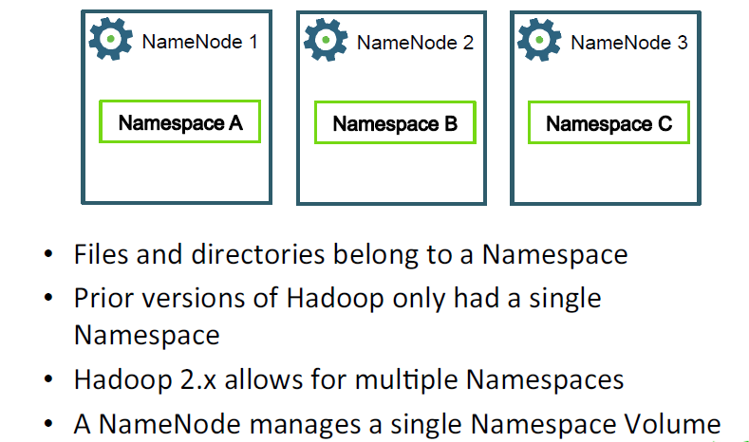
New Components in Hadoop 2.x- Multiple Namespaces
http://www.flower-india.in/

Slide 9
New Components in Hadoop 2.x- HDFS High Availability(HA)
In prior versions of Hadoop, the Name Node was a single point of failure that required additional tools to achieve High Availability
In Hadoop 2.0, Name Node HA is now achieved using the built-in Quorum Journal Manager Framework

Slide 10
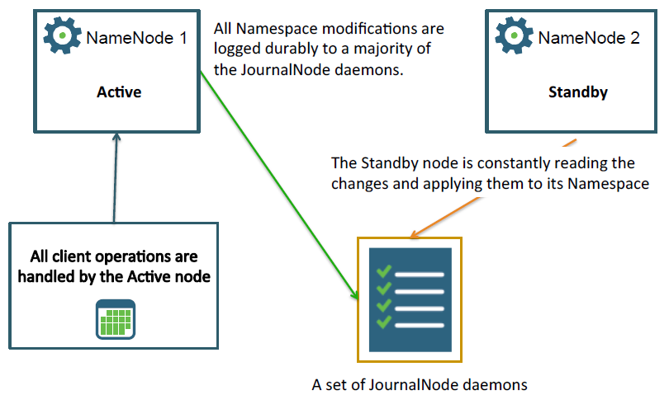
HDFS High Availability(continued).... Quorum Journal Manager
http://www.flower-india.in/

Slide 11
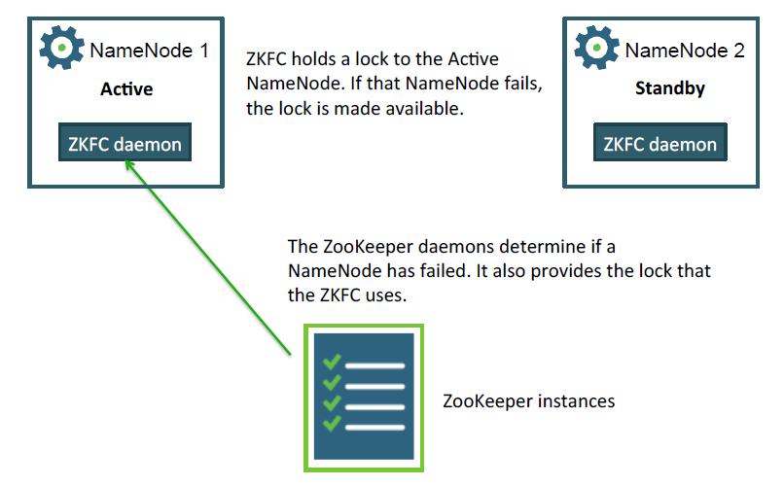
New Components in Hadoop 2.x- Automatic Failover
http://www.flower-india.in/

Slide 12
YARN/MRv2
YARN = Yet Another Resource Negotiator
YARN splits up the functionality of Job Tracker in Hadoop 1.x into two separate processes:
Resource Manager: for allocating resources and scheduling applications
Application Master: for executing applications and providing failover

Slide 13
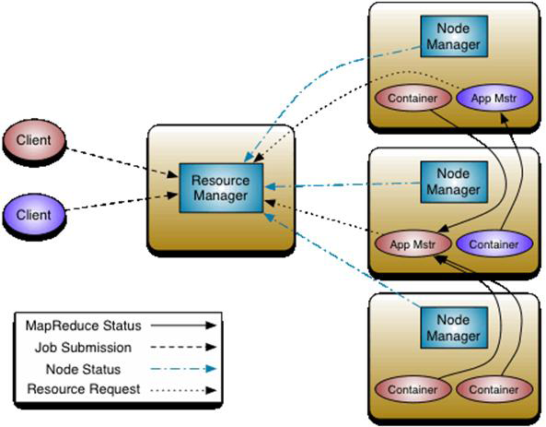
YARN/MRv2(continued)
Resource Management
Job Scheduling & Monitoring
Resource Manager
Scheduler
Applications Manager
Application Master
Node Managers

Slide 14
YARN/MRv2 (continued)
Split up the two major functionalities of the Job Tracker, resource management and job scheduling/monitoring, into separate daemons.
Resource Manager (RM) and per-application Application Master (AM).
The Resource Manager and per-node slave, the Node Manager (NM), form the data-computation framework
The per-application Application Master is, in effect, a framework specific library and is tasked with negotiating resources from the Resource Manager and working with the Node Manager to execute and monitor the tasks.
The Yarn Cluster consists of a single Resource manager which has 2 components
Scheduler – Manages and enforces resource scheduling policy in the cluster, Ex- Capacity scheduler , FIFO scheduler, Fair Scheduler.
Applications Manager – Manages Applications Master in the cluster, i.e., it is responsible for starting application masters and monitoring and restarting them on different nodes in case of failure
The cluster also consists of Containers ,Node Managers(NM) & Application Masters(AM).
There will be as many Application Masters as the number of jobs running.

Slide 15
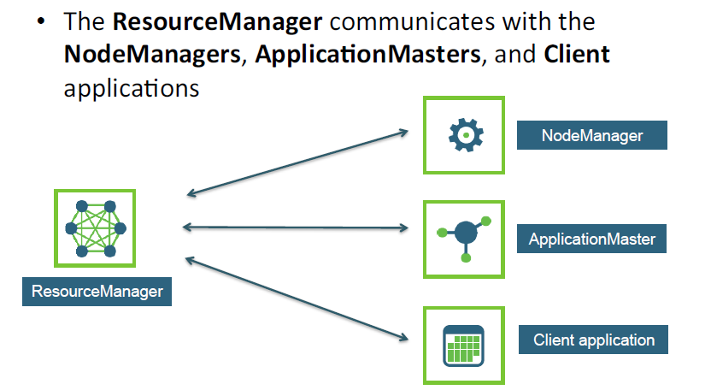
YARN/MRv2- Components of YARN

Slide 16
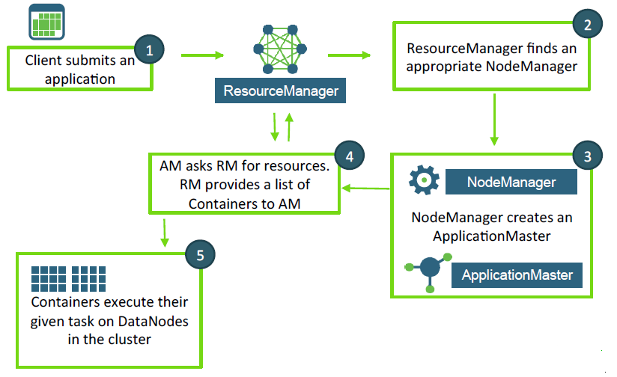
YARN/MRv2- Life cycle of a YARN Application

Slide 17
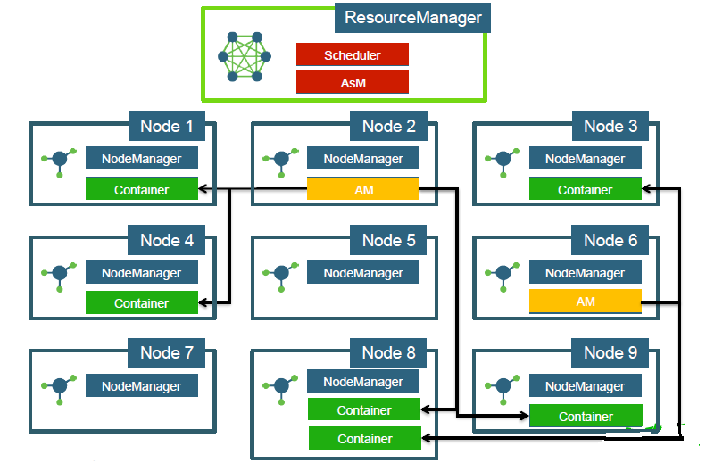
YARN/MRv2- A cluster view example

Slide 18
Quiz
1. True or False: A Name Node can contain multiple namespaces in Hadoop 2.x?
2. What is the key benefit of the new YARN framework?
3. What are the three main components of YARN?

Slide 19
Quiz-Answers
1. False. A Name Node can represent only a single namespace.
2. Hadoop jobs are no longer restricted to Map Reduce. With YARN, any type of computing paradigm can be implemented to run on Hadoop.
3. Resource Manager, Node Manager and Application Master

Slide 20
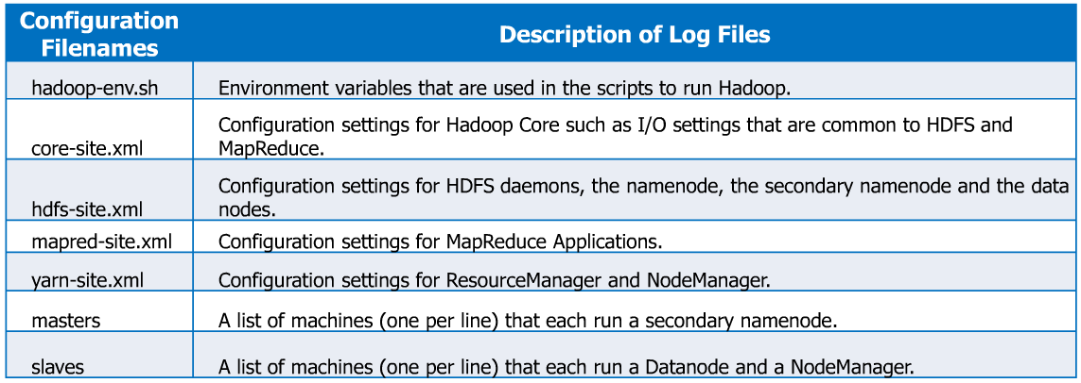
Configuration Files in Hadoop 2.x

Slide 21
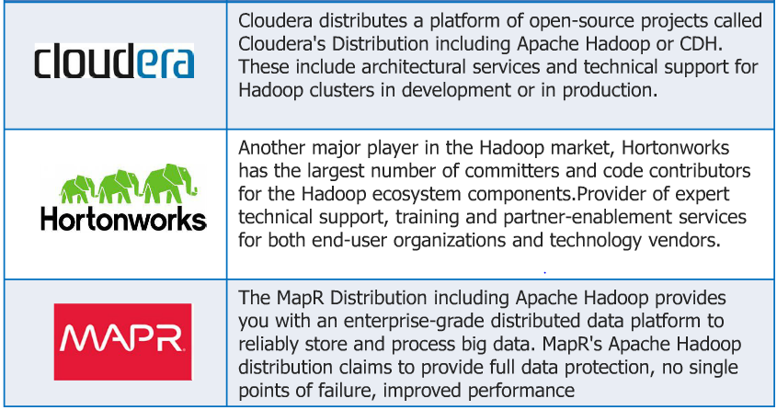
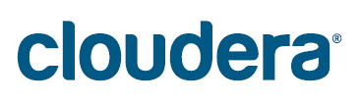
Major Hadoop Distributors/Vendors

Slide 22
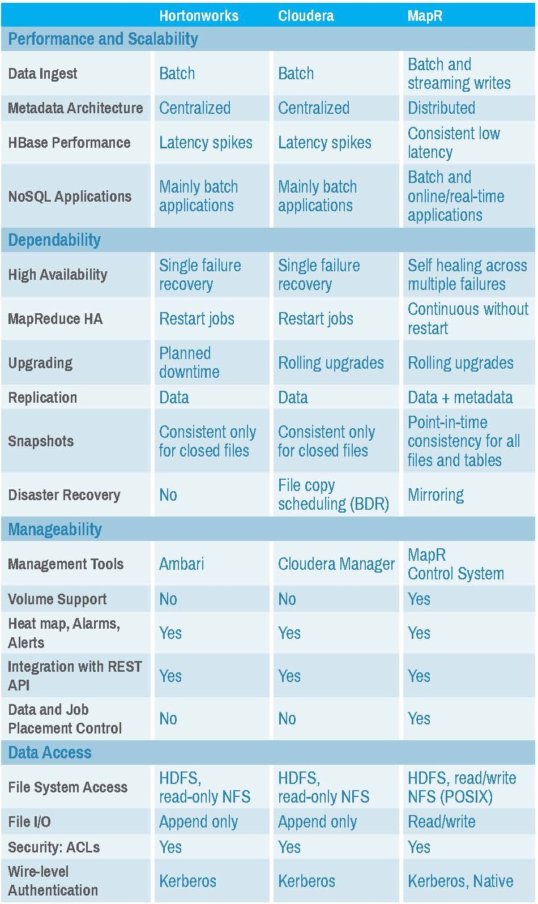
Major Hadoop Distributors/Vendors(continued)

Slide 23
Cluster Management & Monitoring
Apache Ambari
Open source management platform for provisioning, managing, monitoring and securing Apache Hadoop clusters
makes Hadoop management simpler by providing a consistent, secure platform for operational control
provides an intuitive Web UI as well as a robust REST API
Cloudera Manager
Cloudera Manager is an end-to-end application for managing CDH clusters
deploy and centrally operate the complete CDH stack and other managed services
gives you a cluster-wide, real-time view of hosts and services running; provides a single, central console to enact configuration changes across your cluster

Slide 24
Hadoop Downloads
Hadoop can be downloaded from apache website and can be installed on UNIX machine
Alternatively cloudera distribution for hadoop(CDH) can be downloaded from cloudera website
Another option is to download hortonworks from its official website.

Slide 25
Q & A

Slide 26
Thank You

